Slide 1
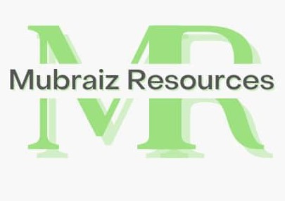
Mubraiz Resources LTD – Company Profile
Empowered by Commitment. Sustained by Integrity.

Slide 2

Mubraiz Resources –
Your trusted partner for comprehensive logistics solutions across Nigeria. Delivering excellence in haulage, distribution, and supply chain management. Mubraiz Resources was incorporated on the 24th July 2019 with BN2911944
Empowered by Commitment. Sustained by Integrity.

Slide 3
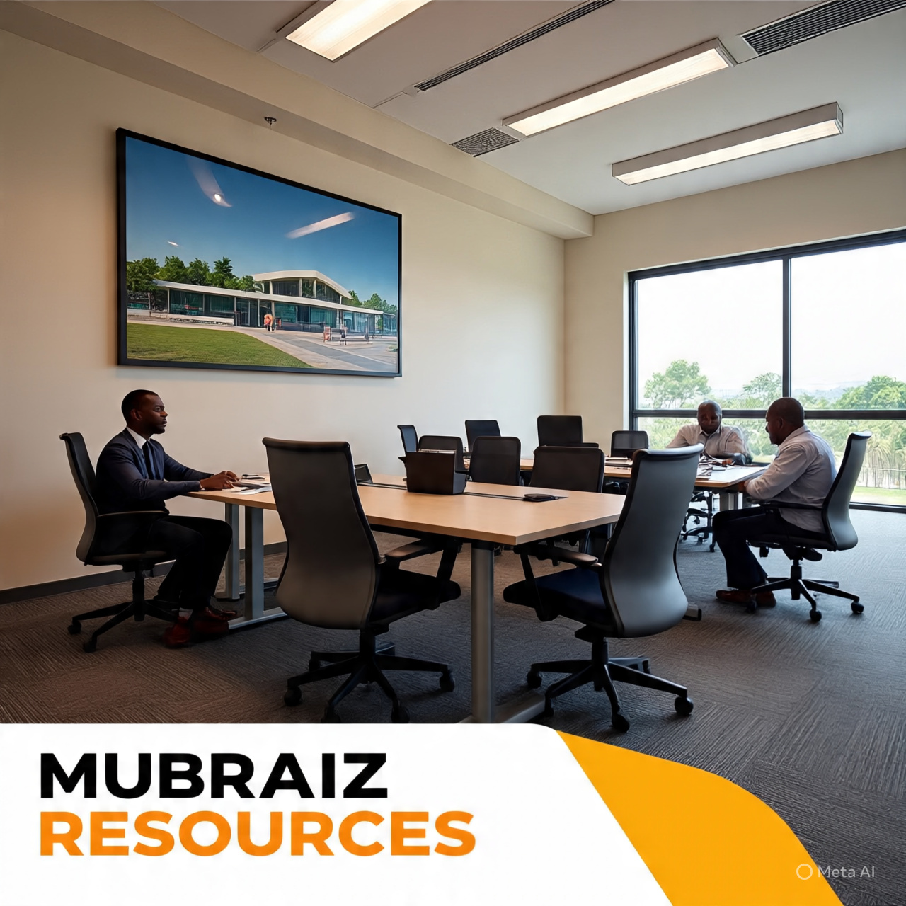
Headquarters
12 Solo Ahamotu Ajibade Babatola Street Ajao Estate, Lagos.
Contact
Branch Office
8 Ajibade Babatola Street Ajao Estate, Lagos
Phone: 08036722216
Email: mubraizresources@gmail.com

Slide 4

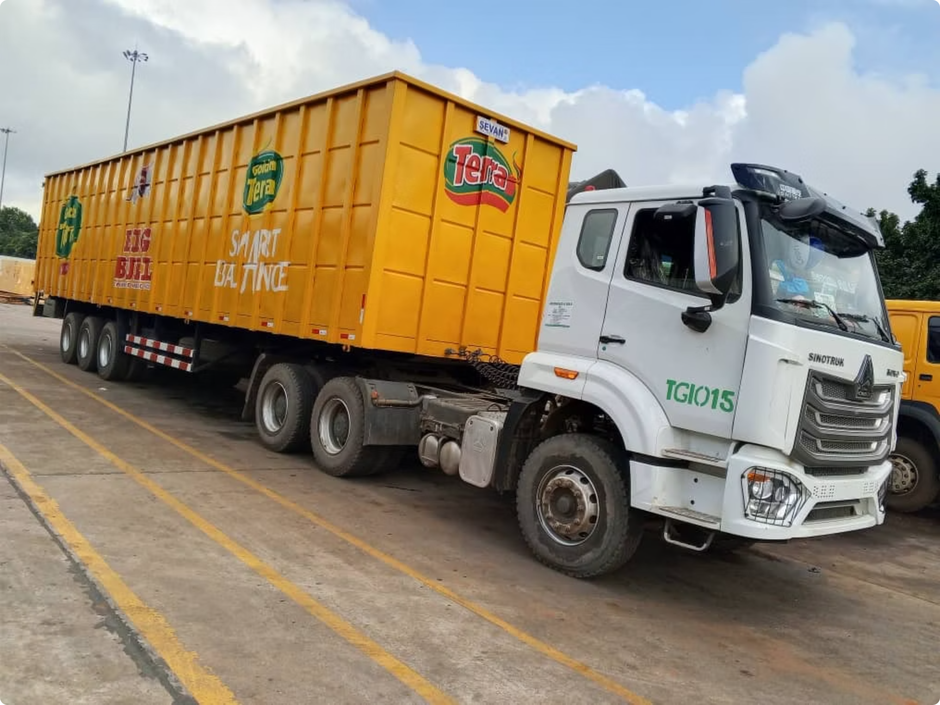
About Mubraiz Resources
Company Foundation
Core Business Areas
Incorporated: 24th July 2019
Road transport and interstate haulage
Registration Number: BN2911944
Warehousing and storage solutions
Customs clearance and forwarding
Industry: Haulage & Logistics
Procurement and supply chain management
Established as a modern logistics enterprise focused on transforming Nigeria's transport landscape through innovative solutions and reliable service delivery.
Our comprehensive approach ensures seamless end-to-end logistics support for businesses across Nigeria.
Modern Fleet
Technology Integration
State-of-the-art trucks including HOWO, DAF, and Mercedes Actros models, engineered for reliability and environmental compliance.
GPS-enabled tracking systems providing real-time monitoring and enhanced security for all shipments nationwide.
Cost Efficiency
Optimised logistics solutions that significantly reduce transportation costs whilst maintaining service quality and reliability.

Slide 5
BACKGROUND
Mubraiz Resources is an indigenous haulage and logistics service provider involved in a diversified business. Mubraiz Resources was incorporated on the 24th of 2019 with BN2911944 as an enterprise to support our clients within Nigeria in their domestic logistics needs. We also offer services related to warehousing, customs, and purchasing.
We pride ourselves in operating a modern and environmentally friendly truck fleet providing safe, reliable service to our customers within Nigeria.
Mubraiz Resources has qualified employees working in the company’s offices, providing a one-stop service with a well-organized service network for haulage of goods. Mubraiz Resources is able to provide excellent services to our valued customers through an integrated logistics chain involving interstate road deliveries.
We are committed to offering trustworthy services in Nigeria through standardized and exceptional customer service solutions. Our company aims at gaining competitive advantages for our customers through whole process monitoring and reducing logistics costs.
Mubraiz Resources has adhered to a carefully balanced development path between company and community, growth and quality. We believe in sustainable growth and advanced company culture, continually working to improve employees’ competence. We endeavour to label Mubraiz Resources with happiness and responsibility.
we identify ourselves as a logistics company in Nigeria and operate within our beloved country Nigeria. We strive to reduce costs, improve productivity, delivering excellent quality services to our customers. The maintenance of high ethical standards in external and internal relationships is our drive towards maximum success.
Decision-making in Mubraiz Resources is based on facts, objectively considered—what we call the fact-founded, thought-through approach. The business activities of our organization are kept in adjustment with the forces at work in its environment, administering business with a sense of competitive urgency.

Slide 6

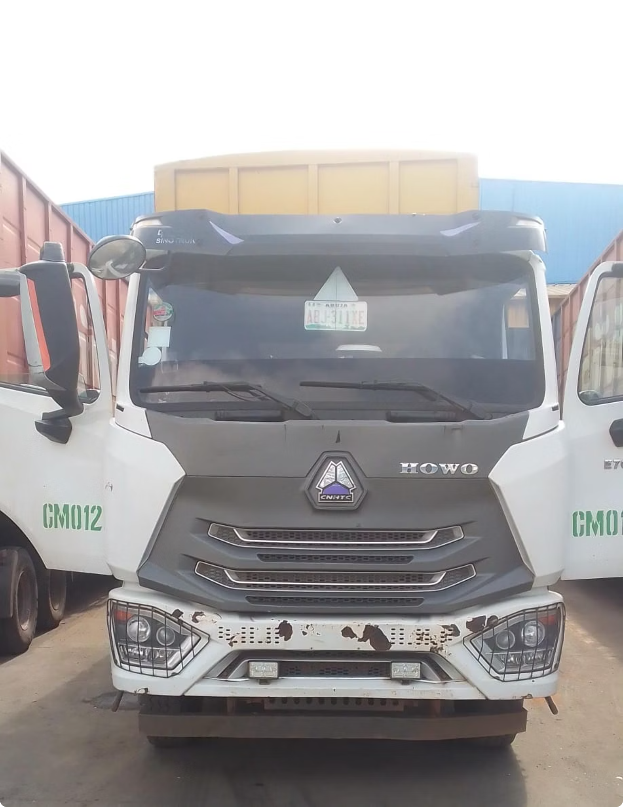




Our Vision & Mission
Our Vision
To become a reliable household name in logistics across Nigeria, setting the benchmark for excellence in transportation and supply chain management.
We envision a future where Mubraiz Resources is synonymous with dependability, innovation, and outstanding customer service throughout the Nigerian logistics landscape.
Our Mission
To deliver excellence in commercial and logistics services using the best people, cutting-edge technology, and world-class resources.
We are committed to providing solutions that exceed client expectations whilst contributing to Nigeria's economic growth through efficient logistics infrastructure.

Slide 7






Core Values That Drive Us
God-fearing
Integrity
We conduct our business with moral integrity, guided by spiritual principles and ethical decision-making in all our operations.
Transparency and honesty form the foundation of our client relationships, ensuring trust and reliability in every transaction.
Equity
Excellence
Fair treatment and equal opportunities guide our approach to partnerships, employment, and business relationships across all levels.
We pursue the highest standards in service delivery, continuously improving our processes and exceeding industry benchmarks.
Loyalty
Professionalism
Dedicated commitment to our clients, partners, and team members, building long-term relationships based on mutual respect and support.
Maintaining the highest standards of expertise, competence, and conduct in all aspects of our logistics and transportation services.

Slide 8
Strategic Objectives
Customer & Market Excellence
Internal Operations Enhancement
People Development
Deliver outstanding customer service that exceeds expectations
Increase operational efficiency through process optimisation
Recruit industry experts and emerging talent
Improve internal communication systems and protocols
Develop strong leadership capabilities at all levels
Expand operations into new regional markets across Nigeria
Align rewards and recognition with performance excellence
Invest strategically in cutting-edge logistics technology
Form strategic alliances with complementary service providers
Foster a culture of continuous learning and innovation
Build lasting partnerships with key industry players
Implement sustainable and environmentally conscious practices
Our greatest asset is our people, and their growth directly contributes to our organisational success.
Our customer-centric approach drives continuous improvement in service quality and market reach.
Streamlined operations enable us to deliver superior value whilst maintaining cost-effectiveness.

Slide 9
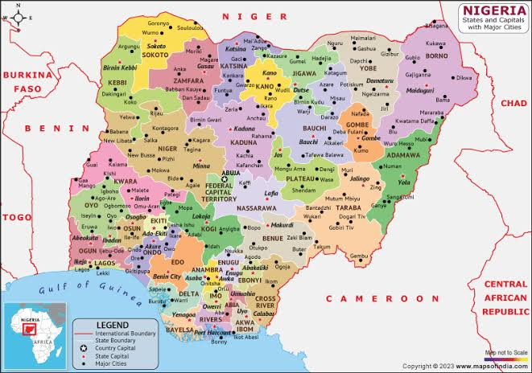
Principal Route and Geographies
With a pan-Nigeria reach, we safely convey goods to all 36 states, providing top-notch logistics solutions to our esteemed clients.

Slide 10
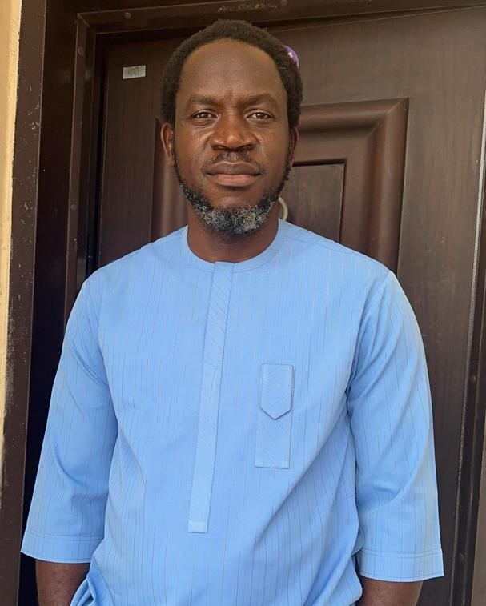
MEET OUR BOARD of directors
Mr. Nebolisa Chidi Johnson
MD / COO
Mr. Nebolisa Chidi Johnson is a distinguished multi-disciplinary executive with a distinguished career in the logistics industry. He holds a bachelor’s degree in accountancy from Rivers State University of Science & Technology (UST) Port Harcourt. With over twenty-five years of experience in top management roles,
Mr. Nebolisa has cultivated a profound understanding of the logistics landscape in Nigeria.
Mr. Nebolisa is marked by a relentless pursuit of excellence and innovation. He is not only a seasoned professional but also the visionary Founder and Managing Director of Mubraiz Resources.

Slide 11
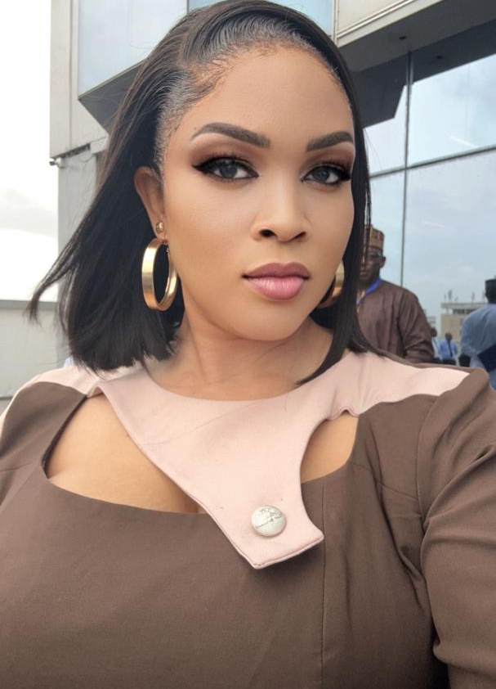
MEET OUR BOARD of directors
MRS. NEBOLISA NNEOMA MIRIAM
Executive Director
Mrs. Nebolisa Nneoma Miriam is a seasoned management executive with a profound academic background. She holds a degree in English/Literature from Abia State University (ABSU) Uturu and is a member of the Nigeria Institute of Management (Chartered). Her career is complemented by extensive training and exposure in Safety Management.
Miriam held various positions in Quality, Health, Safety, and Environment (QHSE) and warehousing with the Genesis Group Headquarters in Port Harcourt. Her journey led her to pioneer the establishment of a parent company,

Slide 12
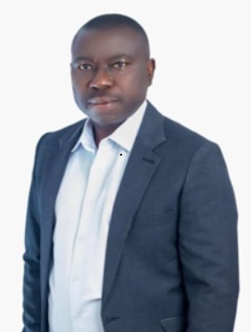
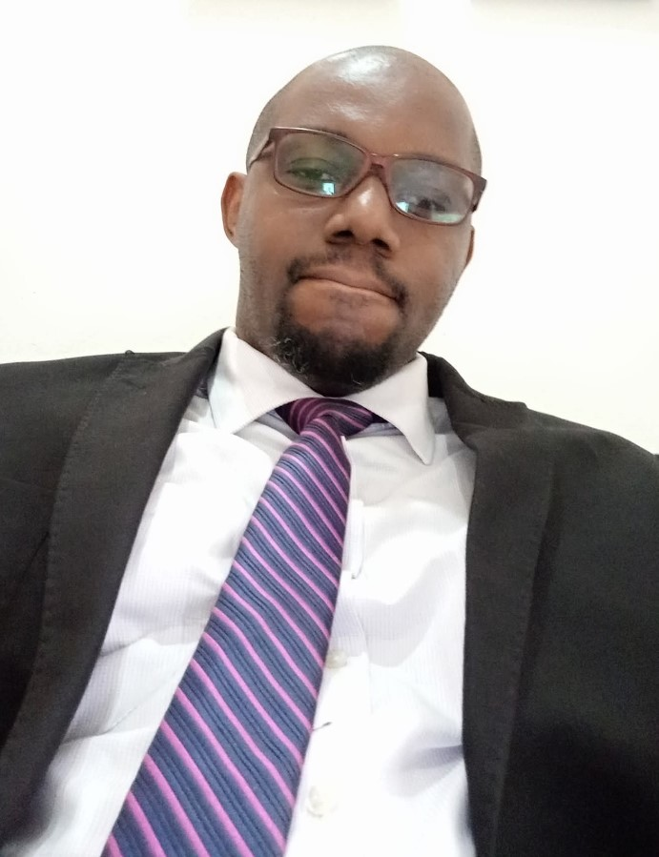
MEET OUR BOARD of directors
Edwin possesses a strong track record as a results-oriented supply chain and logistics manager with over a decade of experience with Diageo optimizing end-to-end supply chain operations. He has demonstrated expertise in improving efficiency, reducing costs, and implementing process enhancements across procurement, inventory management, transportation, and distribution.
Ikechukwu Kalu serves as the Head of Operations at Mubraiz Resources, bringing with him over a decade of experience in the logistics sector. His role is marked by precision and a commitment to operational excellence, Mr Kalu contribution as HOO is integral to our pursuit of operational excellence, reflecting our steadfast commitment to delivering top-tier logistics services.
Mr. Amarime Edwin
Mr. Ikechukwu Kalu
Head of Asset Care Management
Head of Operations

Slide 13
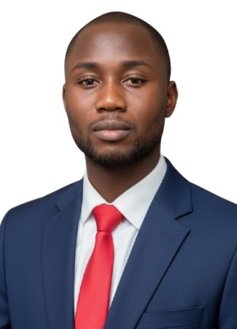
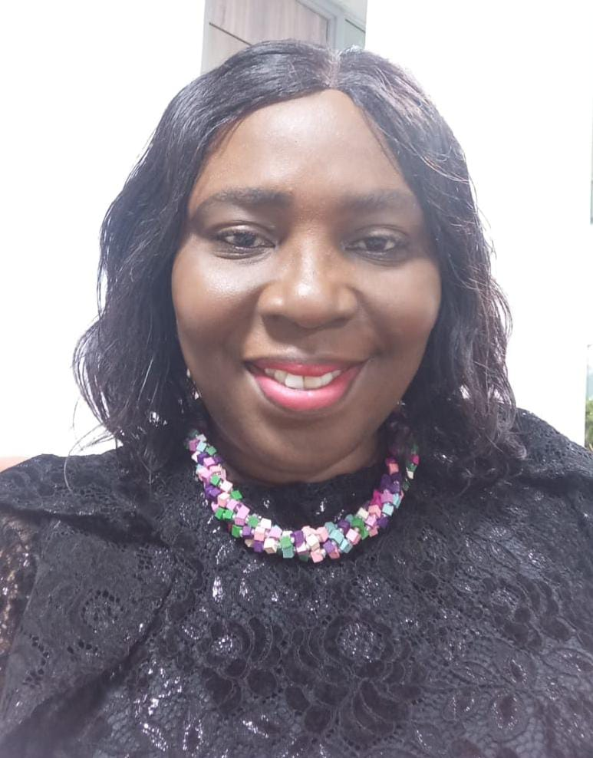
Some of Our MANAGEMENT TEAM
Ayodeji is a seasoned Admin and HR Management professional with a strong background in Transport and Logistics Management. With over 5 years of experience in media and brand management, he has developed a unique blend of skills that enable him to drive business growth and excellence. at Mubraiz Resources, Ayodeji oversees administrative and develops HR strategies to fosters a positive work environment. A Member of the Chartered Institute of Customer Relationship Management. He is a goal-getter, profound leader, and purpose fulfillment crusader dedicated to delivering exceptional results.
Beinmote Alagao serves as the Head of Finance at Mubraiz Resources, bringing with over a decade of experience in the Banking and Finance sector. Her role is marked by precision and a commitment to financial excellence, Mz Beinmote is a graduate of the prestigious University of port harcourt She is a member of the institute of chartered accountant of Nigeria
Mr. Ayodeji Adegunna
Mrs. Beinmote Alagoa
Admin/HR Team Lead
Head of Finance

Slide 14
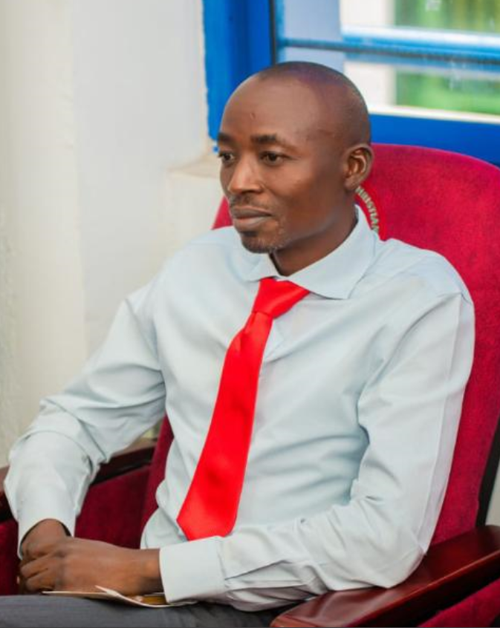

Some of Our MANAGEMENT TEAM
Gyang is Asset Recovery Team Lead, Mubraiz Resources, A Results-driven professional with expertise in asset recovery and management. Having with him over 10 year of expirence as Quality Assurance, Inspection offer and Maintaince cordibatir
Role: Leading the Asset Recovery team at Mubraiz Resources, driving efficient recovery of assets and ensuring optimal resource utilization.
A graduate of Federal Politechnic Bauchi Nigeria
Bar Tekena Ayebatonye Esq is the Lead of TEE LEGAL, A trusted advisers to clients both locally and internationally who seek legal guidance in a fast-paced and multi- jurisdictional World. Bar Tekena is rooted in Nigeria where he provided advisory services to international clients in key jurisdictions around the World not excluding local clients who are involved in cross-border transactions.
An indigent of Beyelsa State of Nigeria which pride himselve in the integrity of purpose, confidentiality, professionalism,
Mr. Gyang Joseph
Bar. Tekena - Ayebatoye Esq
Asset Recovery team Lead
Head of Mubraiz Legal Advisor

Slide 15
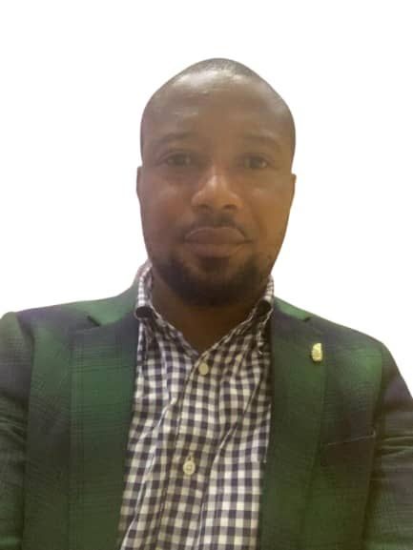
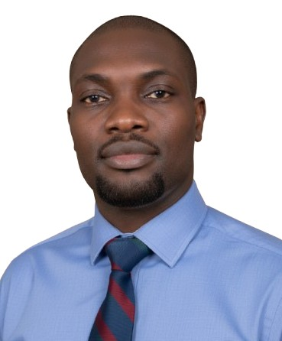
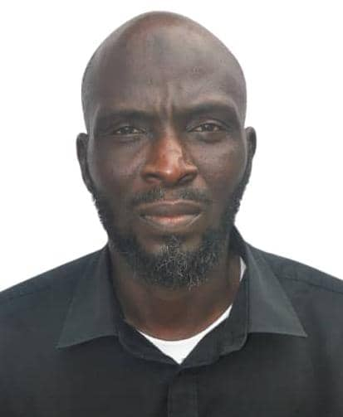
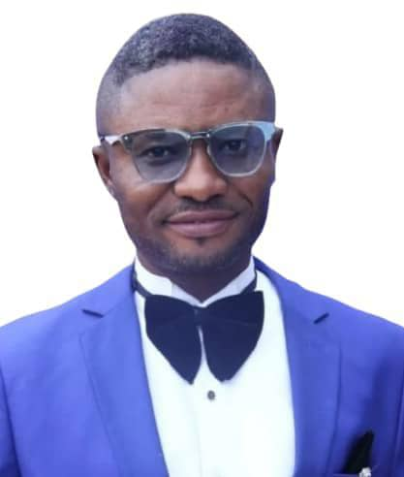
OUR DEDICATED TEAM LEADs
Meet our team of dedicated team lead
Mr. Tejiri Samuel
Mr. Yekeen Aguntasolo
Mr. Obi Odili
Mr. Mueez Niyi
Data Analyst/ Tracking team Lead
Fleet Team Lead (TGI)
Fleet Team Lead (CHI)
Head of HSE team

Slide 16
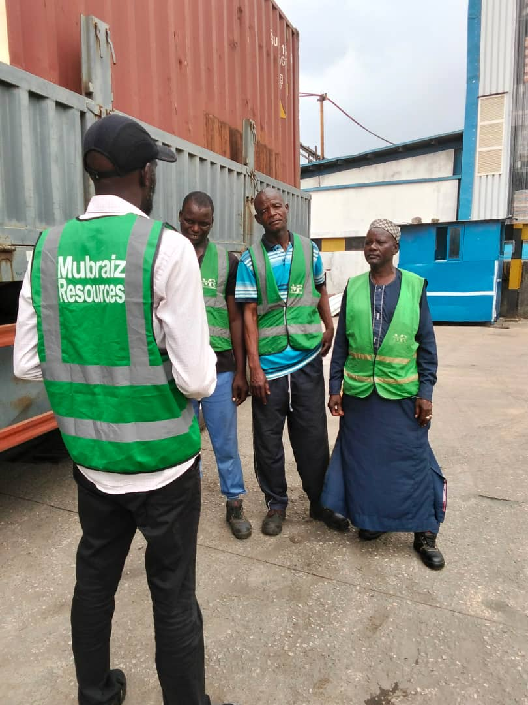
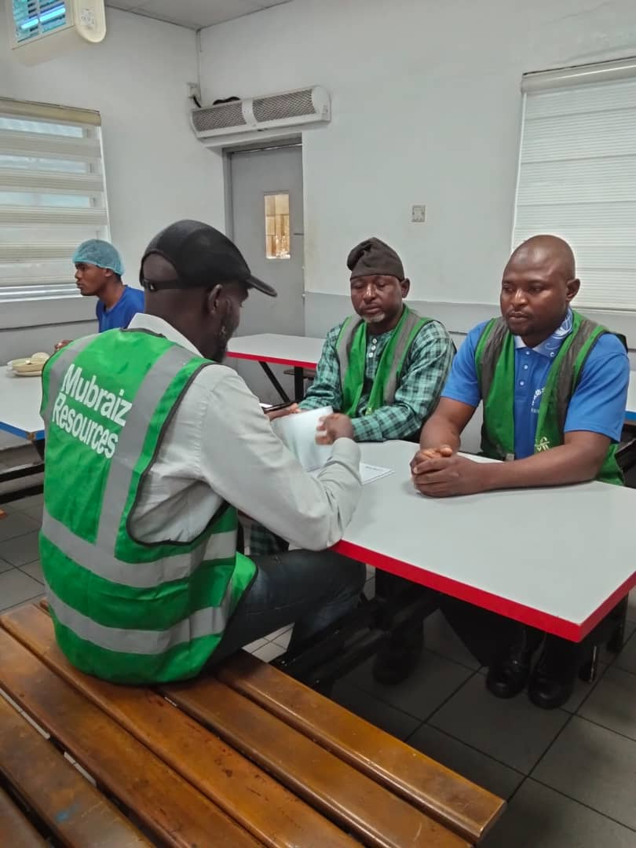
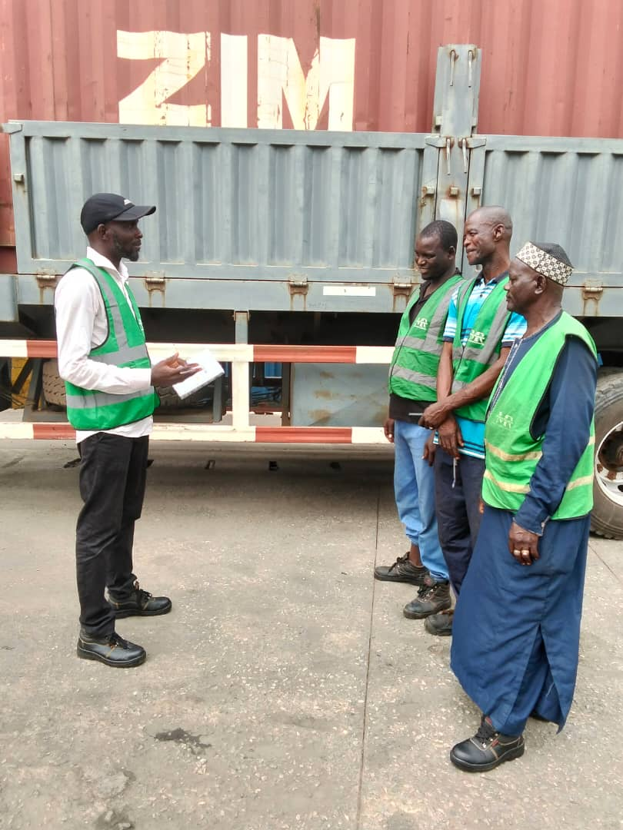
Safety is Our Top Priority.
Fostering a culture of safety, health, and environmental stewardship that drives our business forward and supports the well-being of our stakeholders.
Our HSE Team Lead on Field educating some of our drivers on safty procedures

Slide 17
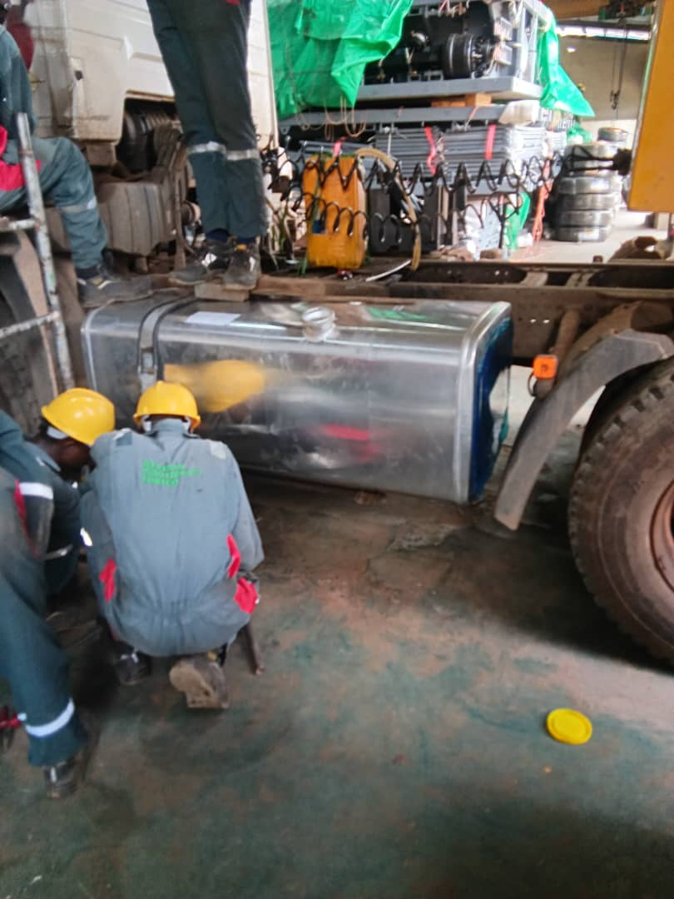
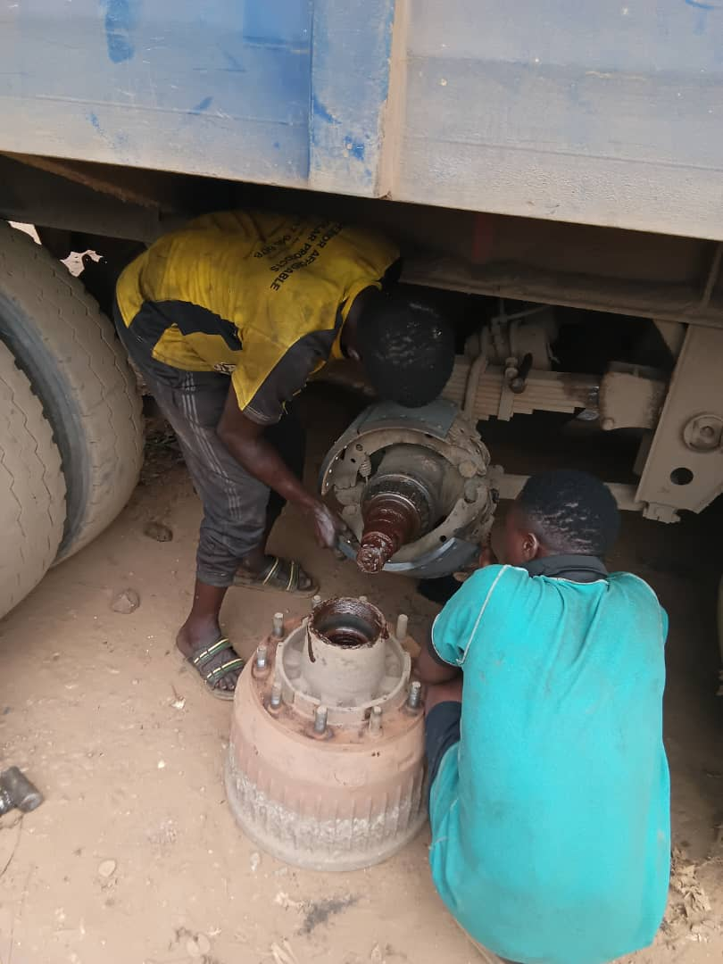
Commitment to Fleet Excellence and Trucks
Road Worthiness
At Mubraiz, we prioritize the safety and reliability of our fleet, ensuring all our trucks are in optimal working condition and meet stringent roadworthiness standards. To achieve this, we employ skilled and certified mechanics who maintain our vehicles with utmost diligence. Additionally, we have established partnerships with reputable service providers, including Zino Trucks, for major repairs and maintenance. This commitment to fleet excellence enables us to deliver efficient, reliable, and safe transportation services to our valued clients.
Our team of dedicated and experience technician and Engineer at work.

Slide 18
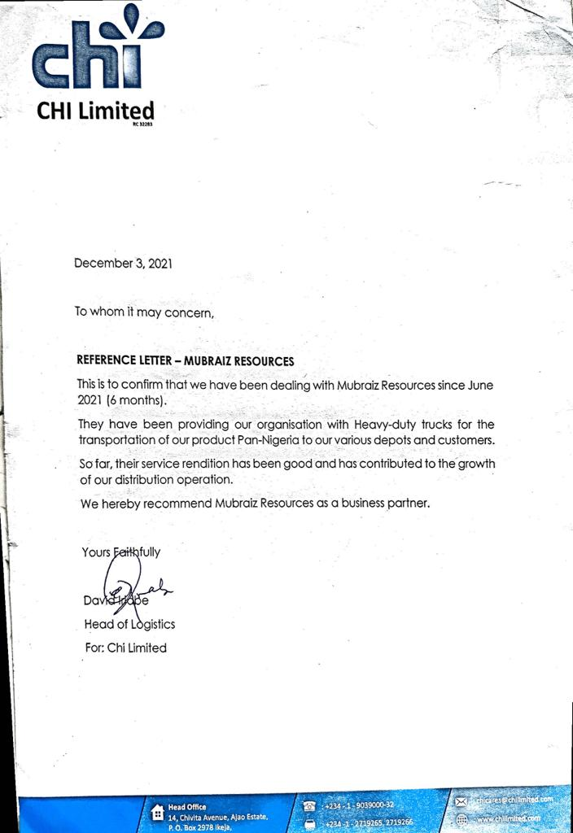
AWARDS & RECOGNITION

Slide 19





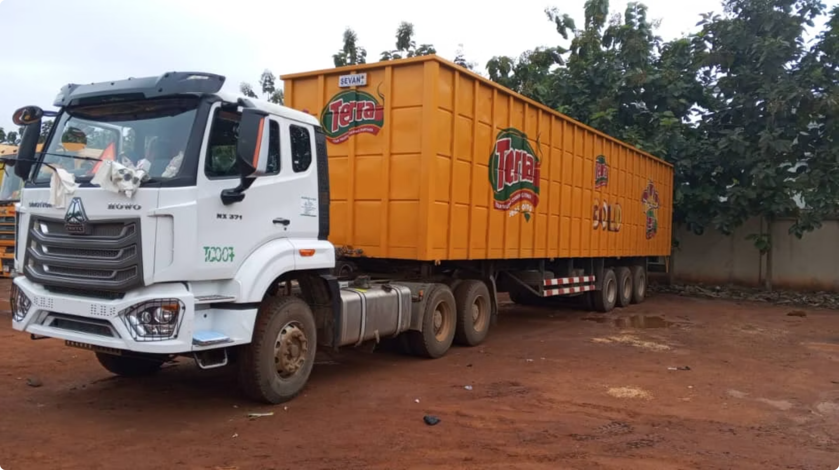


Comprehensive Service Portfolio
Road Haulage & Distribution
Clearing & Forwarding
Nationwide transportation services covering all 36 states, with specialised routes for time-sensitive deliveries and bulk cargo movement.
Expert customs clearance services, cargo handling, and documentation support for seamless import/export operations.
Contract Logistics & Warehousing
Comprehensive warehousing solutions, inventory management, and procurement services tailored to client requirements.
GPS Tracking & Reporting
Real-time vehicle tracking, route optimisation, and detailed reporting systems providing complete visibility of cargo movement and delivery status.
Specialised Heavy Cargo
Expert handling of oversized and heavy cargo transportation with appropriate permits, escort services, and specialised equipment.

Slide 20

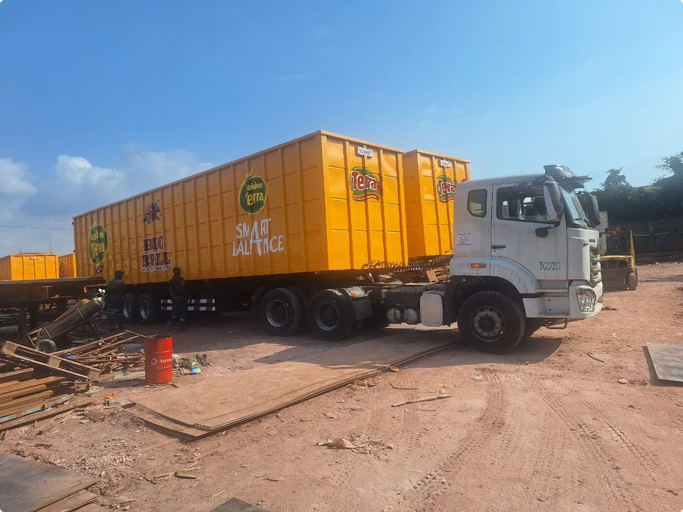

Modern Fleet Specifications
35+
371HP
30t
Total Fleet Size
Engine Power
Maximum Capacity
Modern vehicles across multiple categories
High-performance HOWO specifications
Heavy-duty cargo transportation
HOWO Sino Trucks
DAF Trucks
Mercedes Benz Actros
35 units
10 units
5 units
371HP engine capacity
15-tonne and 30-tonne variants
Premium 30-tonne capacity
Euro II environmental compliance
Exceptional durability
Manual and automatic transmission
Advanced safety features
Robust design for Nigerian roads
Superior driver comfort
European engineering standards
Cost-effective maintenance
Fuel-efficient performance
Maintenance Excellence: Our dedicated maintenance yard located on the Lagos/Ibadan Expressway in Mowe/Ibafo provides comprehensive in-house fueling, servicing, and safety inspections, ensuring optimal fleet performance and reliability.

Slide 21

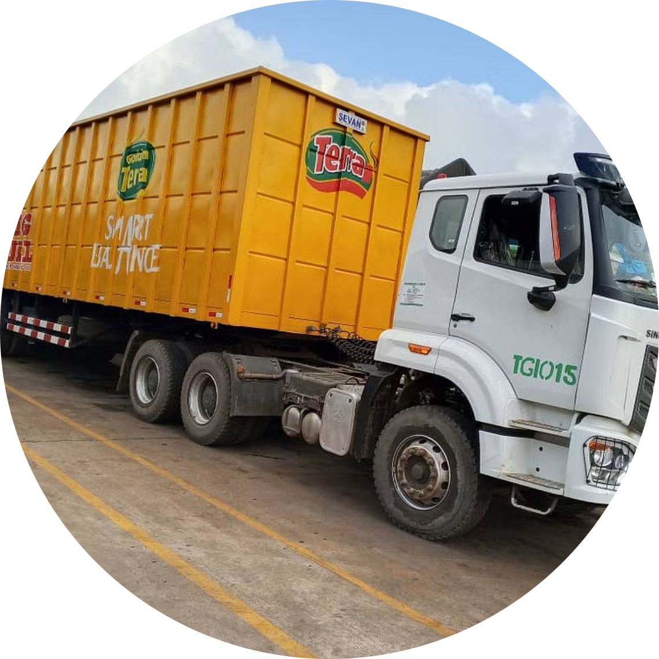
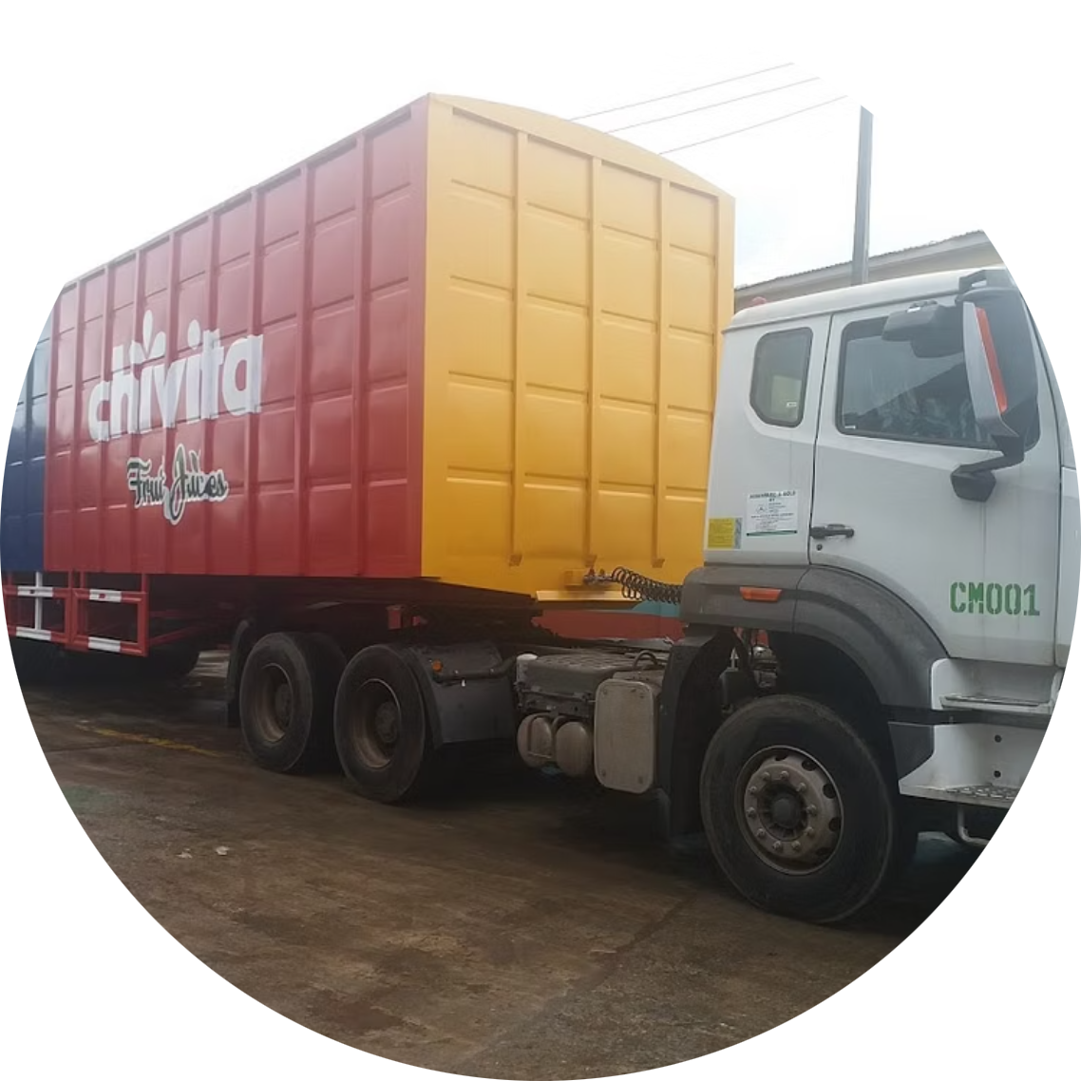
Trusted Client Partnerships
La Casera Plc
TGI Distri
Chi Limited
Comprehensive nationwide product distribution services, ensuring timely delivery of beverages across all Nigerian markets with exceptional reliability and efficiency.
Strategic logistics and distribution partnership providing integrated supply chain solutions and optimised transportation networks for enhanced market reach.
Remarkable growth partnership from initial 5-vehicle support to large-scale fleet management. Officially commended for operational excellence and outstanding service delivery.
"Our client relationships are built on trust, performance, and mutual growth. We don't just transport goods –
we deliver on promises and exceed expectations consistently."
These partnerships demonstrate our ability to scale operations according to client needs whilst maintaining the highest standards
of service quality and reliability across Nigeria's challenging logistics landscape.

Slide 22
Trusted Client Partnerships
At Mubraiz Resources, we take great pride in our enduring relationships with a diverse clientele, exemplifying our commitment to excellence in the logistics industry. We are pleased to present some of our key clients who have entrusted us with their logistics needs, and with whom we have forged strong partnerships.
1. LA CASARA PLC:
- Comprehensive Nationwide Distribution: Mubraiz Resources plays an integral role in facilitating the nationwide distribution of La Casara PLC's extensive range of products. Our reliable services connect their products to every corner of the country, ensuring that they reach their intended destinations efficiently and on time.
2. TGI DISTRI:
- Nationwide Product Distribution: Mubraiz Resources is honoured to be the chosen logistics partner for the nationwide distribution of TGI Distri's wide array of products. Our efficient and reliable services serve as the linchpin in ensuring that their products reach every corner of the nation in a timely manner.
3. CHIVITA LIMITED (CHI LTD):
- A Strong Partnership: Our collaboration with Chi Limited stands as a testament to the enduring power of strong partnerships. In 2021, we initiated our engagement with Chi Limited by deploying a modest fleet of 5 trucks, marking the inception of a logistics relationship.
- Exponential Success: What began as a modest logistics partnership quickly transformed into a resounding success. The management at Chi Limited was sufficiently impressed with our services, prompting them to issue a commendation and express their desire for a deeper and more extensive partnership.

Slide 23




Some of Our Trusted Partnerships
SINOTRUCKS LTD
WAT SERVICE
GAMBUS LIMITED
Zenith Bank PLC
Our partnership with Nigerian Sinotrucks Limited is underpinned by a robust Service Retainership Agreement, which delineates a comprehensive framework for delivering full repair and maintenance services. This collaboration ensures that our fleet consistently operates at its optimal capacity. Nigerian Sinotrucks Limited's unwavering dedication to maintaining our vehicles reflects their commitment to our success.
West African TIRE Services (WATS) is our premier supplier for top-quality tires and expert tire management solutions. Their meticulous oversight ensures optimal tire performance, enhancing safety and efficiency across our operations, setting the standard for reliability in the industry.
Gambus Energy Ltd. is our trusted partner for comprehensive truck and diesel tracking solutions at Mubraiz Resources. With precision and reliability, they streamline our operations, ensuring efficient fleet management and fuel accountability, driving our success forward.
Zenith Bank Plc, our trusted banking partner, plays a pivotal role in facilitating our financial transactions and supporting our financial stability. Their expertise and commitment to excellence in financial services underscore their significance in our operational success.
"Our client relationships are built on trust, performance, and mutual growth. We don't just transport goods –
we deliver on promises and exceed expectations consistently."
These partnerships demonstrate our ability to scale operations according to client needs whilst maintaining the highest standards
of service quality and reliability across Nigeria's challenging logistics landscape.

Slide 24
Some of Our Trusted Partners
Mubraiz Resources acknowledges the paramount role played by our esteemed partners in our journey to provide exceptional logistics and haulage services. These collaborative alliances are the cornerstones of our operational excellence and the foundation of our commitment to customer satisfaction. We proudly showcase five of our key partners:
1. NIGERIAN SINOTRUCKS LIMITED
Our partnership with Nigerian Sinotrucks Limited is underpinned by a robust Service Retainership Agreement, which delineates a comprehensive framework for delivering full repair and maintenance services. This collaboration ensures that our fleet consistently operates at its optimal capacity. Nigerian Sinotrucks Limited's unwavering dedication to maintaining our vehicles reflects their commitment to our success.
2. Zenith Bank Plc: Our Banking Partner
Zenith Bank Plc, our trusted banking partner, plays a pivotal role in facilitating our financial transactions and supporting our financial stability. Their expertise and commitment to excellence in financial services underscore their significance in our operational success.
3. Gambus Energy Ltd
Gambus Energy Ltd. is our trusted partner for comprehensive truck and diesel tracking solutions at Mubraiz Resources. With precision and reliability, they streamline our operations, ensuring efficient fleet management and fuel accountability, driving our success forward.
4.West African Tire Services
West African TIRE Services (WATS) is our premier supplier for top-quality tires and expert tire management solutions. Their meticulous oversight ensures optimal tire performance, enhancing safety and efficiency across our operations, setting the standard for reliability in the industry.

Slide 25
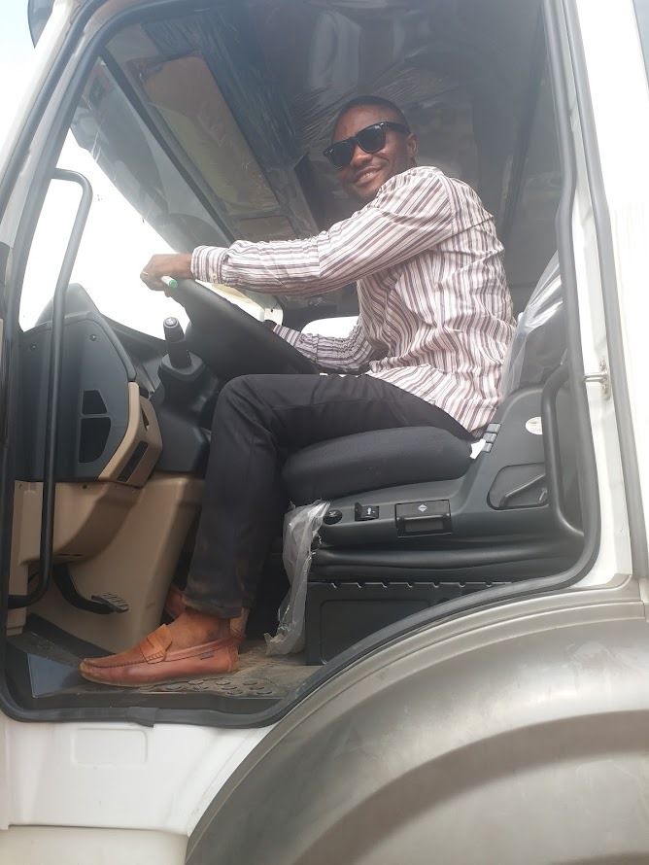
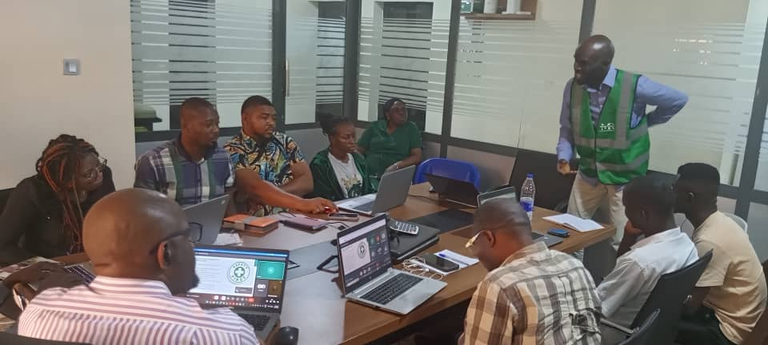
Embracing Individuality and Respect in the Workplace
At Mubraiz, we celebrate the unique perspectives and strengths that each individual brings to our team. We believe in fostering an environment where everyone feels empowered to express themselves authentically and contribute to our collective success.
* Individuality * Respect * Open Expression * Inclusive Environment

